Slide 1
Large Language Model Implementation
Zifu Wang, June 22, 2024

Slide 2
Environment
Programming Language: Python 3.10
Tools:
Anaconda:
https://docs.anaconda.com/anaconda/install/windows/
LM Studio:
https://lmstudio.ai/
VS Code Studio:
https://code.visualstudio.com/Download

Slide 3

Encoder: processes the input sequence and generates a set of encoded representations that capture the contextual information of the input.
Decoder: generates the output sequence (e.g., translated text) based on the encoded representations from the encoder and previously generated tokens in the output sequence.

Slide 4
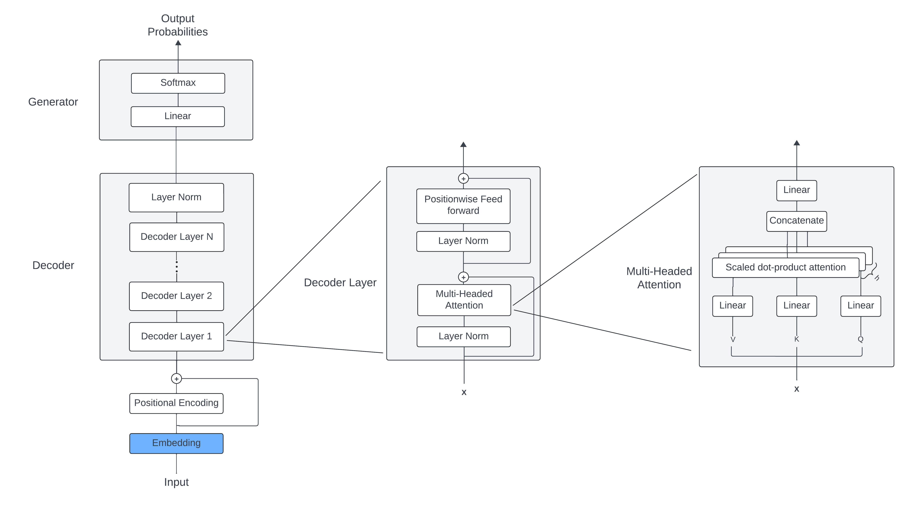
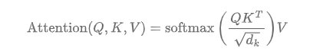
GPT Model Structure

Slide 5
Questions zwang31@gmu.edu

